Slide 1
Using Simple QDA Software with Participants:
Results from a Pilot Study
Dr Daniel Turner
daniel@quirkos.com
www.quirkos.com

Slide 2
Power to the Participants!
‘Intoxication’ of Dionysus vs
‘Clarity’ of Apollo

Slide 3
Why?
Power
Setting agendas
Better results

Slide 4
How?
Question development
Data generation
Analysis

Slide 5
Participant checking
Summary engagement
Triangulation
Question validation /
development / population
Participant led
Consensus or challenge?

Slide 6
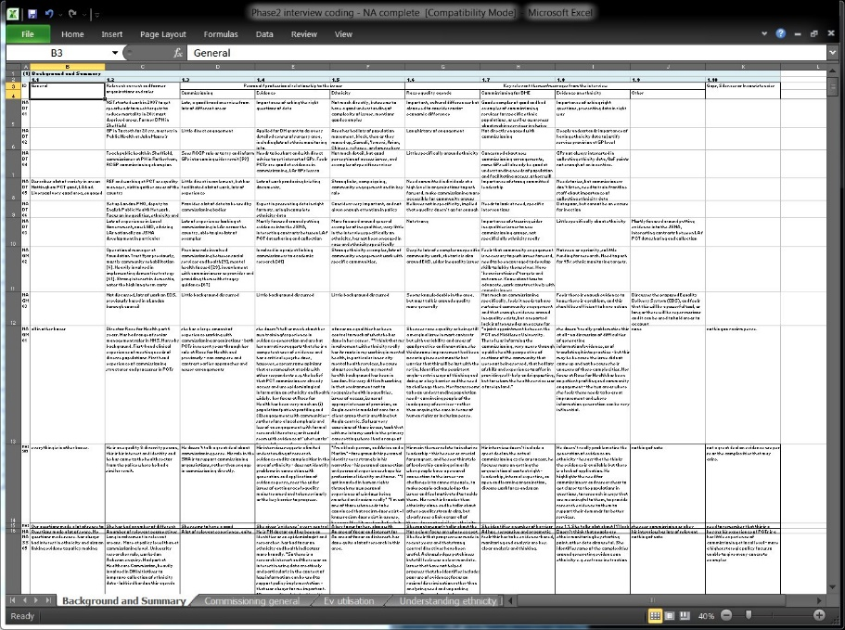
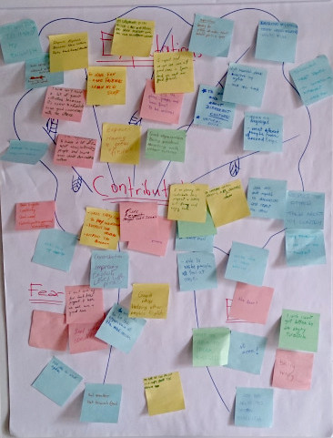
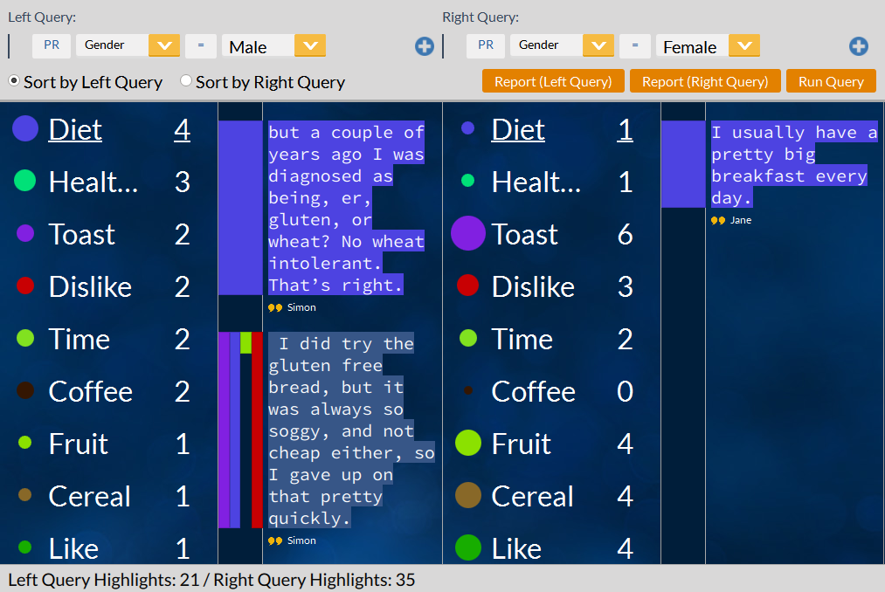
Can technology be a facilitator?
<
?

Slide 7
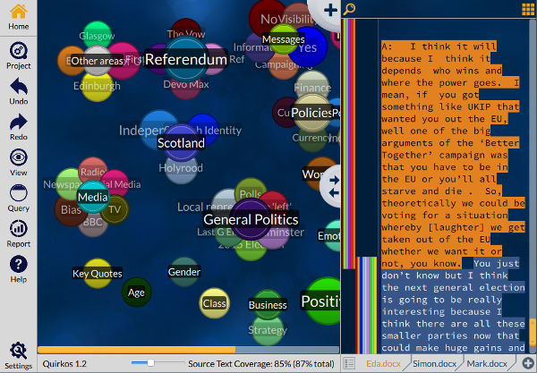
Scottish Referendum Project
12 Semi-structured interviews
Participant analysis
+
Quirkos Simple qualitative analysis software Easy and quick to learn

Slide 8
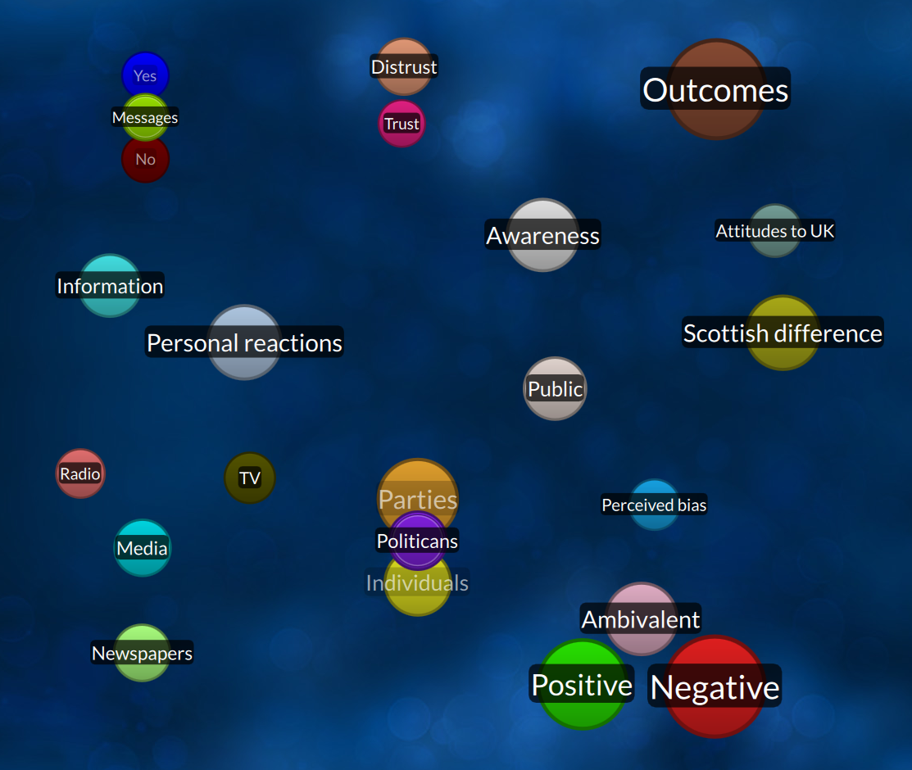
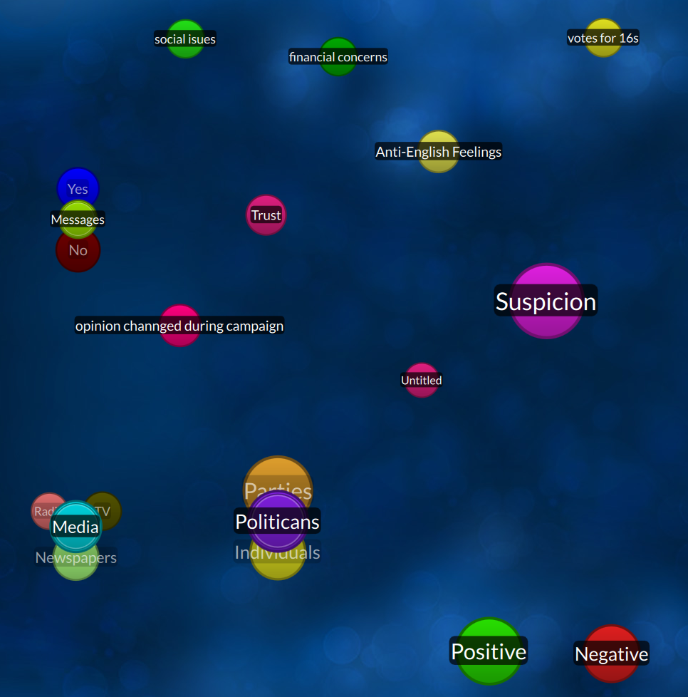
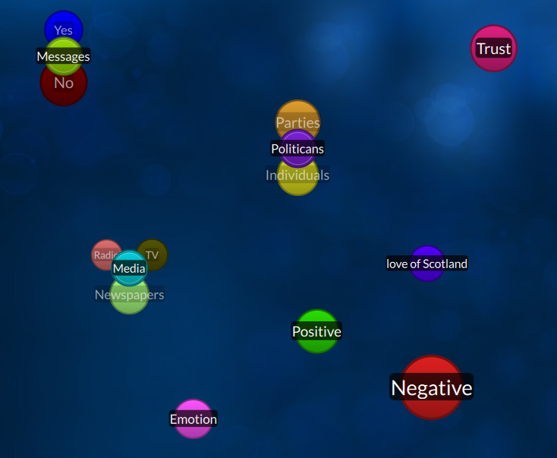
a
e
h

Slide 9
average: 25 21 16

Slide 10
Quotes from participants
My view on what the categories mean or what the person is saying might change before the end, so I could have actually read the whole thing through before doing the comments
I started adding in categories, and then thinking, ooh, if I’d added that in earlier I could actually have tied it up to such-and-such comment
I thought that bit revealed a lot about her political beliefs, and I could feel my emotions entering into my judgement, I felt very negative about her comments, so I decided to leave it,

Slide 11
Quotes from participants
Suspicion, oh yeah, that’s negative trust. Love of Scotland, oh! I put anti-English feelings which is the opposite! Ours are like inverse pictures of each other’s!
I think I’m better at… quant… quantitative, where this is qual? Qualitative. Subjective stuff. I think I am better at numbers and graphs.
I also didn’t want to leave any comment unclassified, but we could do, couldn’t we? That to me is about the mechanics of using the computer, ticky box thing.

Slide 12
Conclusions
It can work*!
Coding was quick and easy
Useful feedback and grounding
Validates approach for wider use
Method not as important as process?

Slide 13
Questions
When is this useful / desirable?
Capacity of participants?
How to capture / integrate data?
Full data and summary reports available at: www.quirkos.com/workshops/referendum
More on the workshop methods at www.quirkos.com/blog
Dr Daniel Turner
daniel@quirkos.com
www.quirkos.com

